Slide 1
Feature subset selection using embedded approach- (LASSO_regression)
Faculty:
Dr. K. Aditya Shastry
Associate Professor
Dept. of ISE
NMIT
Student Name and USN:
Hoysala.N -(1NT17IS071)
Navachethan.M- (1NT18IS099)

Slide 2
Feature subset selection
What is Feature subset selection?(Dimensionality reduction)
Why Feature subset selection?(to over come curse of dimensionality)
Importance of Feature subset selection?
It enables the machine learning algorithm to train faster.
It reduces the complexity of a model and makes it easier to interpret.
It improves the accuracy of a model if the right subset is chosen.
It reduces overfitting.

Slide 3
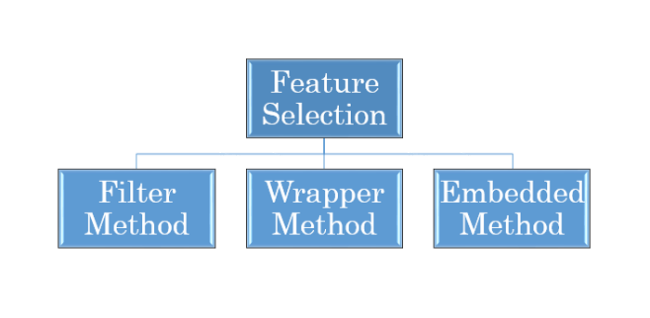
Types of Feature subset selections:

Slide 4

Filter method:
Methodology:
Pearson’s Correlation
LDA -Linear discriminant analysis
ANOVA -ANOVA stands for Analysis of variance
Chi-Square test

Slide 5
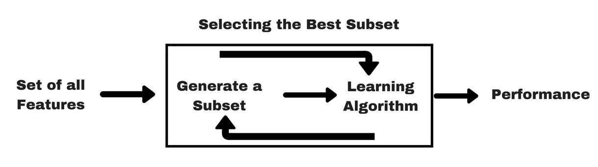
Wrapper method:
Methodology:
Forward Selection
Backward Elimination
Recursive Feature elimination

Slide 6
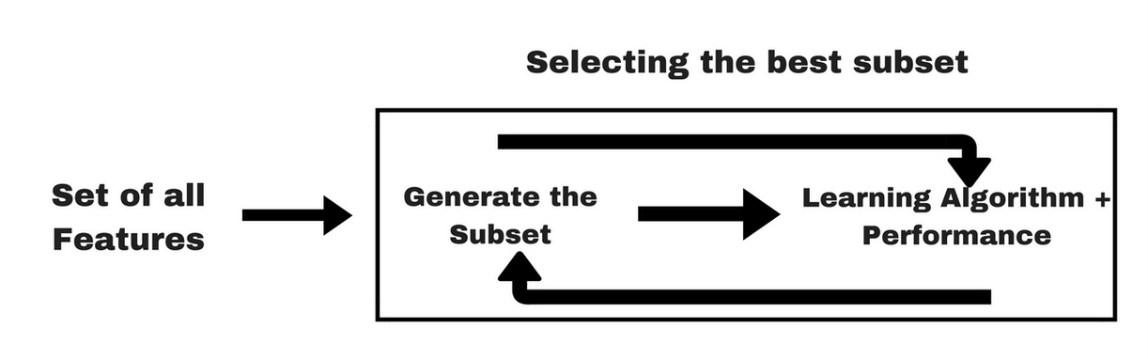
Embedded method:
Embedded methods combine the qualities’ of filter and wrapper methods. It’s implemented by algorithms that have their own built-in feature selection methods.
Examples:
Lasso regression performs L1 regularization which adds penalty equivalent to absolute value of the magnitude of coefficients.
Ridge regression performs L2 regularization which adds penalty equivalent to square of the magnitude of coefficients.
Tree algorithms such as random forest, Extra tree, etc..

Slide 7
Advantages of Embedded Methods:
They take into consideration the interaction of features like wrapper methods do.
They are faster like filter methods.
They are more accurate than filter methods.
They find the feature subset for the algorithm being trained.
They are much less prone to over-fitting.

Slide 8
Algorithm Based Approach:
This can be done using any kind of tree-based algorithm like Decision Tree, RandomForest or ExtraTree, XGBoost and so on.
The split takes place on a feature within the algorithm to find the correct variable.
The algorithm tries all possible ways of split for all the features and chooses the one that splits the data best. This basically means it uses wrapper method as all the possible combinations of features is tried and the best one is picked.
For classification the split happens typically either the Gini impurity or information gain/entropy and for Regression the split happens with the help of the variance.
With the help of this method we can find feature importance's and can remove feature below certain threshold.

Slide 9
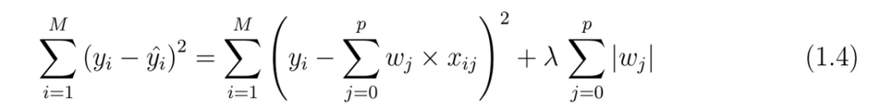

LASSO(Least Absolute Shrinkage and Selection Operator)_regression:
Least Absolute Shrinkage and Selection Operator(Lasso) is one of the powerful methods that helps perform regularization and feature selection of the given data.
The Lasso method puts a limitation/restrictions on the sum of the values of the model parameters.
The sum has to be less than the specific fixed value.
This Shrinks some of the coefficients to zero, Indicating that a certain predictor or certain features will be multiplied by zero to estimate the target.
During this process the variables that have non-zero co-efficient after shrinking are selected to be the part of the model.
It also adds a penalty term to the cost function of a model, with a lambda value that must be tuned.

Slide 10
Importance of α -coefficient:
Lasso regression performs L1 regularization, i.e. it adds a factor of sum of absolute value of coefficients in the optimization objective. Thus, lasso regression optimizes the following:
Objective = RSS + α * (sum of absolute value of coefficients)
Here, α (alpha) is the parameter which balances the amount of emphasis given to minimizing RSS vs minimizing sum of square of coefficients. α can take various values:
α = 0: Same coefficients as simple linear regression
α = ∞: All coefficients zero. (No model can be constructed since feature values will become 0)
0 < α < ∞: coefficients between 0 and that of simple linear regression

Slide 11
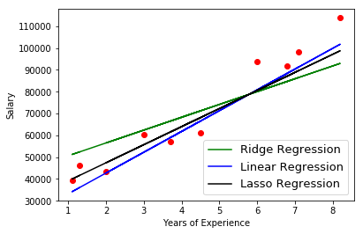

Slide 12

Algorithm:

Slide 13
References
“A small review and further studies on the LASSO”- Sunghoon Kwon Sangmi Han Sangin Lee Department of Applied Statistics, Konkuk University Department of Statistics, Seoul National University Received 4 July 2013, revised 12 August 2013, accepted 23 August 2013 Journal of the Korean Data &Information Science Society2013, 24(5), 1077{1088.
“Feature Selection using LASSO” Research Paper in Business Analytics Author: Valeria Fonti Supervisor: Dr. Eduard Belitser March 30, 2017- VU Amsterdam .
“A Hybrid Embedded-Filter Method for Improving Feature Selection Stability of Random Forests”- Wassila Jerbi, Afef Ben Brahim, and Nadia Essoussi- Conference Paper in Advances in Intelligent Systems and Computing · February 2017.
“ESFS: A new embedded feature selection method based on SFS “-Zhongzhe Xiao, Emmanuel Dellandrea, Weibei Dou, Liming Chen - jan 2008
www.analyticsvidhya.com/blog/2016/01/ridge-lasso-regression-python-complete-tutorial/
medium.com/analytics-vidhya/feature-selection-for-dimensionality-reduction-embedded-method-e05c74014aa
towardsdatascience.com/ridge-and-lasso-regression-a-complete-guide-with-python-scikit-learn-e20e34bcbf0b

Slide 14
Thank you

